Slide 1
学术写作、规范与伦理
学术论文写作与发表规范 - II
张晗
2022.10

Slide 2
01
02
03
04
结构的逻辑性
语句的逻辑性
论证的逻辑性
写作规范
05
06
07
08
Abstract，Title &
Keywords
Introduction
论文主体
Conclusion

Slide 3
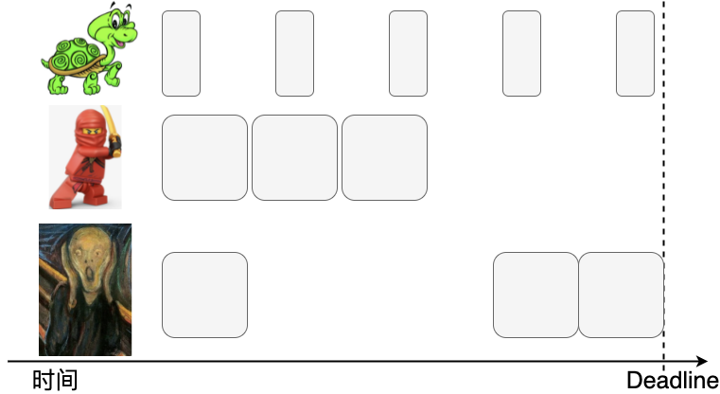
论文各部分的写作习惯
平时就把每次与导师、同学的讨论结果添加到latex中！
好处
讨论完成了，论文大体也就完成了
更早地double-check，发现错误之处，早做修改
帮助完善你的论文逻辑，及早发现还缺什么
从一开始就统一符号，便于与你的导师、同学讨论

Slide 4
论文各部分的写作顺序
Abstract/ Title/ Keywords
Problem Formulation
论文主体部分
Introduction
论文阅读顺序
论文写作顺序
Main Result
Problem Formulation
Numerical Examples
论文主体部分
Main Result
Introduction
Numerical Examples
Conclusion
Conclusion
Abstract/ Title/ Keywords

Slide 5
01
02
03
04
结构的逻辑性
语句的逻辑性
论证的逻辑性
写作规范
05
06
07
08
Abstract，Title &
Keywords
论文主体
Introduction
Conclusion

Slide 6
论文主体部分的写法
Problem formulation
Main Result
Numerical Examples

Slide 7
论文主体部分的写法
Problem formulation
Main Result
Numerical Examples
核心是告诉读者：What is the research problem？
一篇好文章80%以上的工作在于一个好的problem formulation→决定了后续应采用什么样的数学工具和分析手段
后续文章的证明、讨论以及实验都围绕着problem formulation展开
使用易读、易于理解的notation

Slide 8
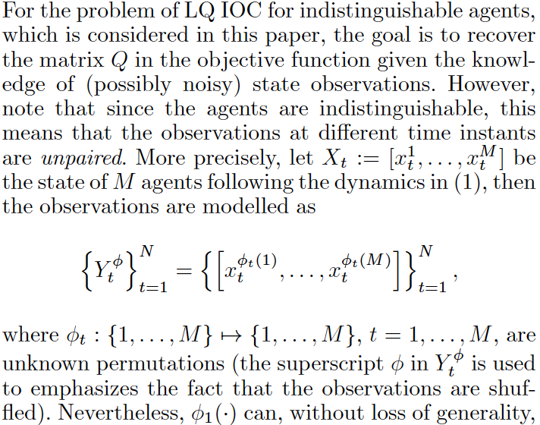
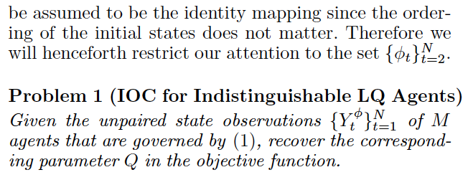
论文主体部分的写法
Problem formulation
Main Result
Numerical Examples
需清楚、严谨地用数学语言描述要做的问题
公式的写法：仍是一句句子，要保证阅读的通畅
建议醒目地用“Problem”标注本文所考虑的问题

Slide 9
论文主体部分的写法
To search for common patterns in fresh water age and ocean age (separate analyses) among the seven different river systems, as well as to test for the influence of covariates, we used a multivariate autoregressive state–space modelling approach. With MARSS, we are trying to explain temporal variation in a set of n observed time-series using linear combinations of autocorrelated processes (potentially shared across time-series), covariates, additional linear trend and error. The model consists of a state equation and an observation equation.
The state equation,
represents a vector of unobserved autocorrelated process overtime. Here, $x_{t}$is the unobserved value of the state(s) at time t, B is the auto correlation in the state(s), c are potential covariates that explain the autocorrelated state(s) and the irrespective coefficients, C, and u is a possible linear trend. The process error ($w_{t}$) follows a multivariate normal distribution centred on zero with a covariance matrix Q.
The observation equation relates…

Slide 10
论文主体部分的写法
To search for common patterns in fresh water age and ocean age (separate analyses) among the seven different river systems, as well as to test for the influence of covariates, we used a multivariate autoregressive state–space modelling approach. With MARSS, we are trying to explain temporal variation in a set of n observed time-series using linear combinations of autocorrelated processes (potentially shared across time-series), covariates, additional linear trend and error. The model consists of a state equation and an observation equation.
The state equation,
represents a vector of unobserved autocorrelated process overtime. Here, $x_{t}$is the unobserved value of the state(s) at time t, B is the auto correlation in the state(s), c are potential covariates that explain the autocorrelated state(s) and the irrespective coefficients, C, and u is a possible linear trend. The process error ($w_{t}$) follows a multivariate normal distribution centred on zero with a covariance matrix Q.
The observation equation relates…
Aim

Slide 11
论文主体部分的写法
To search for common patterns in fresh water age and ocean age (separate analyses) among the seven different river systems, as well as to test for the influence of covariates, we used a multivariate autoregressive state–space modelling approach. With MARSS, we are trying to explain temporal variation in a set of n observed time-series using linear combinations of autocorrelated processes (potentially shared across time-series), covariates, additional linear trend and error. The model consists of a state equation and an observation equation.
The state equation,
represents a vector of unobserved autocorrelated process overtime. Here, $x_{t}$is the unobserved value of the state(s) at time t, B is the auto correlation in the state(s), c are potential covariates that explain the autocorrelated state(s) and the irrespective coefficients, C, and u is a possible linear trend. The process error ($w_{t}$) follows a multivariate normal distribution centred on zero with a covariance matrix Q.
The observation equation relates…
Which model

Slide 12
论文主体部分的写法
To search for common patterns in fresh water age and ocean age (separate analyses) among the seven different river systems, as well as to test for the influence of covariates, we used a multivariate autoregressive state–space modelling approach. With MARSS, we are trying to explain temporal variation in a set of n observed time-series using linear combinations of autocorrelated processes (potentially shared across time-series), covariates, additional linear trend and error. The model consists of a state equation and an observation equation.
The state equation,
represents a vector of unobserved autocorrelated process overtime. Here, $x_{t}$is the unobserved value of the state(s) at time t, B is the auto correlation in the state(s), c are potential covariates that explain the autocorrelated state(s) and the irrespective coefficients, C, and u is a possible linear trend. The process error ($w_{t}$) follows a multivariate normal distribution centred on zero with a covariance matrix Q.
The observation equation relates…
Rationale

Slide 13
论文主体部分的写法
To search for common patterns in fresh water age and ocean age (separate analyses) among the seven different river systems, as well as to test for the influence of covariates, we used a multivariate autoregressive state–space modelling approach. With MARSS, we are trying to explain temporal variation in a set of n observed time-series using linear combinations of autocorrelated processes (potentially shared across time-series), covariates, additional linear trend and error. The model consists of a state equation and an observation equation.
The state equation,
represents a vector of unobserved autocorrelated process overtime. Here, $x_{t}$is the unobserved value of the state(s) at time t, B is the auto correlation in the state(s), c are potential covariates that explain the autocorrelated state(s) and the irrespective coefficients, C, and u is a possible linear trend. The process error ($w_{t}$) follows a multivariate normal distribution centred on zero with a covariance matrix Q.
The observation equation relates…
Model equations

Slide 14
论文主体部分的写法
To search for common patterns in fresh water age and ocean age (separate analyses) among the seven different river systems, as well as to test for the influence of covariates, we used a multivariate autoregressive state–space modelling approach. With MARSS, we are trying to explain temporal variation in a set of n observed time-series using linear combinations of autocorrelated processes (potentially shared across time-series), covariates, additional linear trend and error. The model consists of a state equation and an observation equation.
The state equation,
represents a vector of unobserved autocorrelated process overtime. Here, $x_{t}$is the unobserved value of the state(s) at time t, B is the auto correlation in the state(s), c are potential covariates that explain the autocorrelated state(s) and the irrespective coefficients, C, and u is a possible linear trend. The process error ($w_{t}$) follows a multivariate normal distribution centred on zero with a covariance matrix Q.
The observation equation relates…
Equations Descriptions

Slide 15
论文主体部分的写法
Problem formulation
Main Result
Numerical Examples
核心是告诉读者：How the research problem is solved？
将主要结果分块展示
公式的写法：仍是一句句子，要保证阅读的通畅
每块结果可以适当地小结

Slide 16
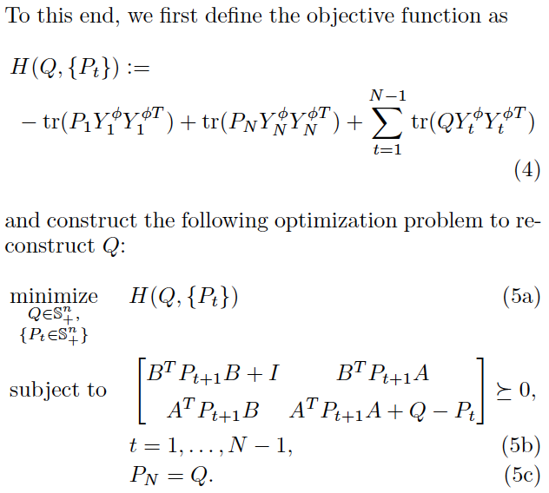
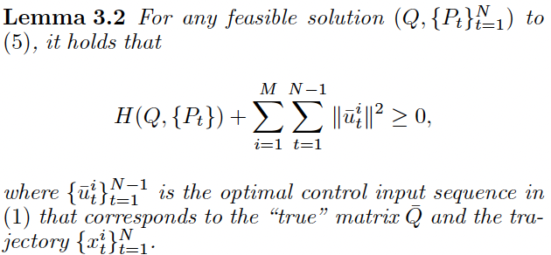
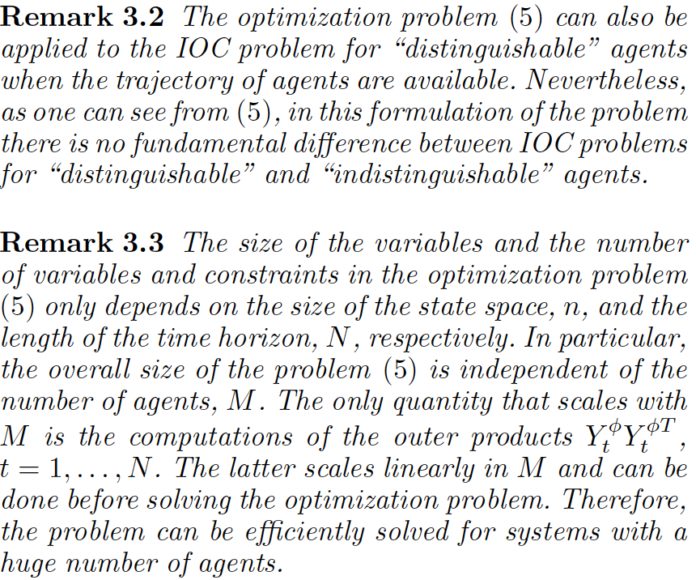
论文主体部分的写法
Problem formulation
Main Result
Numerical Examples
解这个优化问题的目的
Uniqueness of the optimal solution
Bounded from below
Construct the optimization problem
小结
True value is the optimal solution

Slide 17
论文主体部分的写法
Problem formulation
Main Result
Numerical Examples
核心是告诉读者：What is the performance of the proposed method?
正文与图的Caption要区分开，有所侧重
正文：讲清实验是如何做的，叙述你希望读者明白的“趋势”或“要素”
Caption：向读者如实地叙述并分析数据

Slide 18
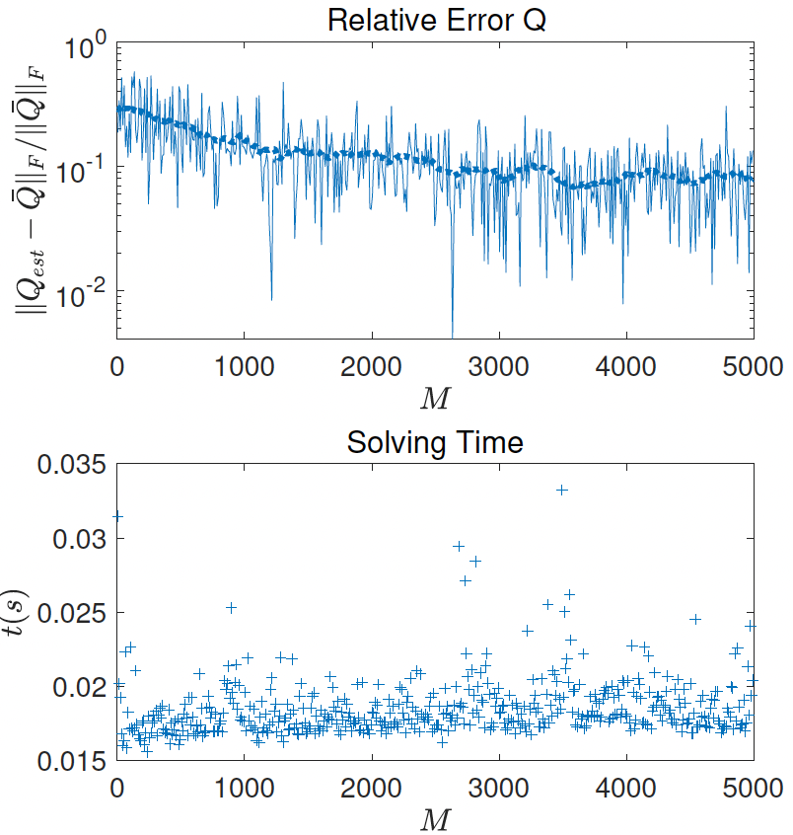
论文主体部分的写法
Caption：
The upper plot shows the relative estimation error of Q, akin to the relative errors in Fig.3.
The lower plot shows the time it took (in seconds) to solve the corresponding optimization problem.

Slide 19
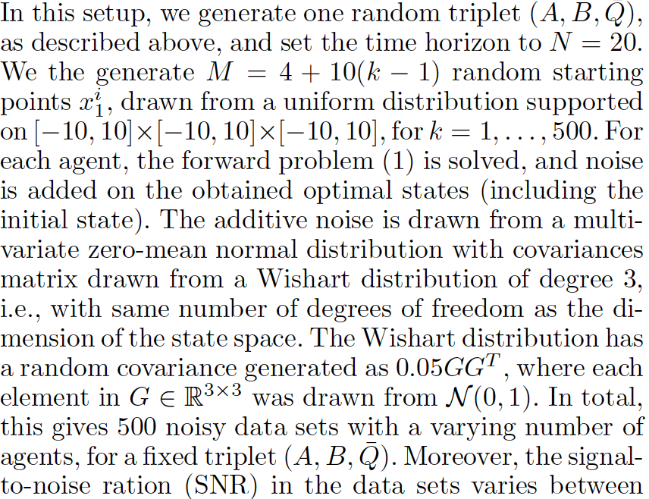
论文主体部分的写法
正文：“实验是如何做的”

Slide 20
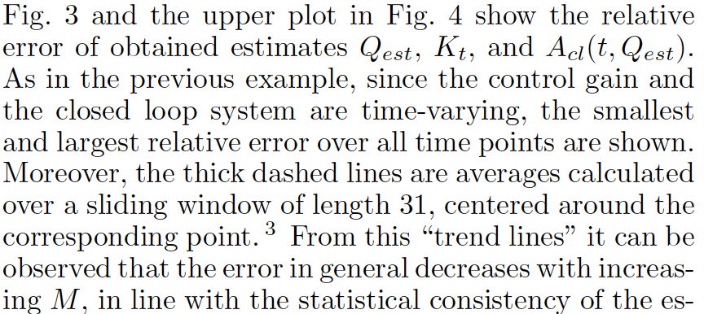
论文主体部分的写法
正文：“趋势”与“要素”

Slide 21
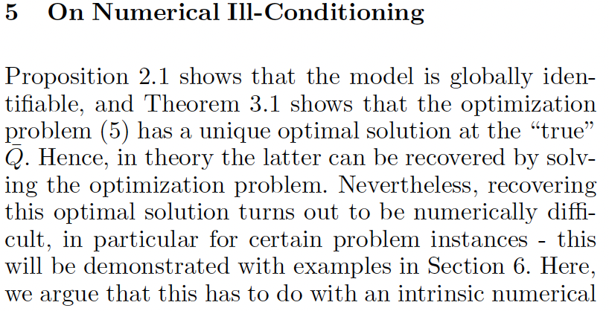
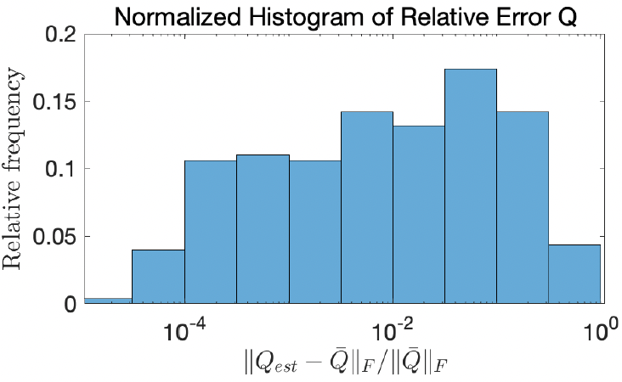
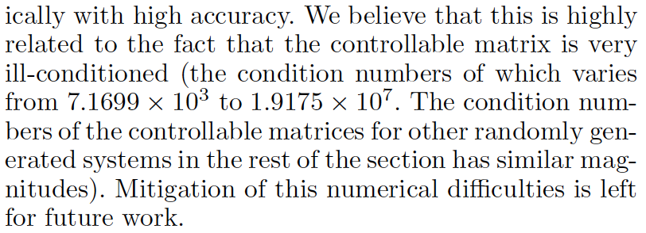
论文主体部分的写法
报告负面的结果：
如果负面结果不影响你文章的贡献
给出负面结果可能的原因
把对负面结果的改进作为future work
告诉读者估计的误差大可能是由于系统能控性矩阵Ill-Conditioned造成的

Slide 22
01
02
03
04
结构的逻辑性
语句的逻辑性
论证的逻辑性
写作规范
05
06
07
08
Abstract，Title &
Keywords
论文主体
Introduction
Conclusion

Slide 23
Introduction的写法
为什么要做该研究？？？
Background
问题背景
为了确保读者具备足够的知识来理解你工作的重要性！
Aim

Slide 24
Introduction的写法
这两篇文章应该投到电子领域的期刊还是材料领域的期刊？
One of the main challenges for today’s information networks is to reduce power consumption while increasing speed of data transfer. In conventional networks, electrical signal is processed, transferred, and read by metallic interconnects, where dense packing and speed of data processing are limited by Joule heating and parasitic capacitance, respectively. Silicon photonics, on the contrary, holds promise for increasing speed and power efficiency of the these networks. However, challenges in the design of integrated light emitting devices and photo detector shave prevented the realization of practical circuits.
The continuing exploration of the properties of two-dimensional (2D) materials and the integration of these materials into new technologies requires reliable synthesis methods. The potential of scaling up existing approaches, however, remains uncertain. This is due to factors such as the growth substrates and conditions, small crystal sizes and the instability of the synthesized materials. For example, top-down liquid-phase exfoliation is a promising approach for the production of large quantities of various atomically thin layered materials, including graphene, transition metal dichalcogenides and boron nitride. However, poor control over thickness uniformity and the small size of the derived materials undermines the viability of the approach…

Slide 25
Introduction的写法
这两篇文章应该投到电子领域的期刊还是材料领域的期刊？
“One of the main challenges for today’s information networks is to reduce power consumption while increasing speed of data transfer. ”
“The continuing exploration of the properties of two-dimensional (2D) materials and the integration of these materials into new technologies requires reliable synthesis methods. ”
One of the main challenges for today’s information networks is to reduce power consumption while increasing speed of data transfer. In conventional networks, electrical signal is processed, transferred, and read by metallic interconnects, where dense packing and speed of data processing are limited by Joule heating and parasitic capacitance, respectively. Silicon photonics, on the contrary, holds promise for increasing speed and power efficiency of the these networks. However, challenges in the design of integrated light emitting devices and photo detector shave prevented the realization of practical circuits.
The continuing exploration of the properties of two-dimensional (2D) materials and the integration of these materials into new technologies requires reliable synthesis methods. The potential of scaling up existing approaches, however, remains uncertain. This is due to factors such as the growth substrates and conditions, small crystal sizes and the instability of the synthesized materials. For example, top-down liquid-phase exfoliation is a promising approach for the production of large quantities of various atomically thin layered materials, including graphene, transition metal dichalcogenides and boron nitride. However, poor control over thickness uniformity and the small size of the derived materials undermines the viability of the approach…
剩下的内容都在比较silicon photonics和传统网络的传输速度
剩下的内容都在叙述编织2D材料的挑战
应投至材料领域的期刊！
应投至电子领域的期刊！

Slide 26
Introduction的写法
Extended background on data transfer speeds

Slide 27
Introduction的写法
Extended background 2D fabrication

Slide 28
Introduction的写法
为什么要做该研究？？？
Background
问题背景
为了确保读者具备足够的知识来理解你工作的重要性！
问题的科学描述
让读者对你要解决的问题有一个大致的了解
Inverse Optimal Control (IOC) is an inverse problem whose aim is to reconstruct the cost function and predict the closed-loop system‘s behaviour, based on knowledge of the underlying system dynamics and observations of the system. The problem can be categorized as a system identification problem where the system is assumed to be governed by an optimal control model with known structure, and hence it is a so-called gray-box system identification problem.
Aim

Slide 29
Introduction的写法
为什么要做该研究？？？
Background
问题背景
为了确保读者具备足够的知识来理解你工作的重要性！
问题的科学描述
让读者对你要解决的问题有一个大致的了解
前人工作(What is known)
让读者了解最新的研究做成什么样了，局限是什么
切忌文献堆砌——按Claim、Describe、Limitation叙述
Aim

Slide 30
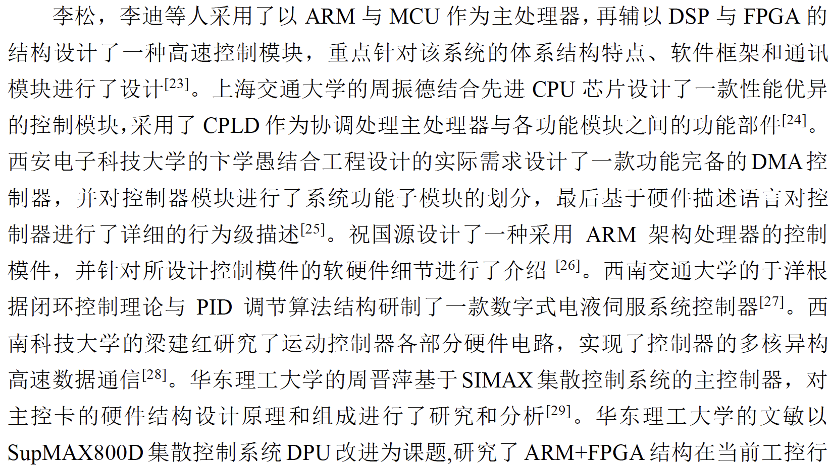
Introduction的写法
例：文献堆砌

Slide 31
Introduction的写法
例子：
Automatic cutting control is a kind of complex task in the field of robotic manipulation of deformable objects. It is difficult to describe the cutting process analytically because of the time-varying nonlinear dynamics [6]. Gemici et al. propose a method to model and learn physical properties (e.g., hardness, elasticity, adhesiveness, etc.) of the deformable objects based on haptic sensory, which can be used to cut and separate different kinds of food (e.g., tomatoes, bread, tofu, etc.) [10]. Straizys et al. propose a strategy of cutting along the boundary between two soft mediums [11]. A binary classifier based on the joint torque measurements is trained to determine the probability that the cutting tool is in the certain medium and adjust the trajectory accordingly. Mu et al. divide cutting into three stages: press, push, and slice, and design controllers are based on force feedback to achieve the automatic cutting of food [12]. However, the tissue’s deformation during the cutting process is not studied. A hybrid force/vision control is proposed in [13], which uses a dual robot system, one for cutting while the other for pulling to minimize deformation, yet the dual robot system cannot be fulfilled in some cases.
Claim

Slide 32
Introduction的写法
例子：
Automatic cutting control is a kind of complex task in the field of robotic manipulation of deformable objects. It is difficult to describe the cutting process analytically because of the time-varying nonlinear dynamics [6]. Gemici et al. propose a method to model and learn physical properties (e.g., hardness, elasticity, adhesiveness, etc.) of the deformable objects based on haptic sensory, which can be used to cut and separate different kinds of food (e.g., tomatoes, bread, tofu, etc.) [10]. Straizys et al. propose a strategy of cutting along the boundary between two soft mediums [11]. A binary classifier based on the joint torque measurements is trained to determine the probability that the cutting tool is in the certain medium and adjust the trajectory accordingly. Mu et al. divide cutting into three stages: press, push, and slice, and design controllers are based on force feedback to achieve the automatic cutting of food [12]. However, the tissue’s deformation during the cutting process is not studied. A hybrid force/vision control is proposed in [13], which uses a dual robot system, one for cutting while the other for pulling to minimize deformation, yet the dual robot system cannot be fulfilled in some cases.
Describe and get support from current studies

Slide 33
Introduction的写法
例子：
Automatic cutting control is a kind of complex task in the field of robotic manipulation of deformable objects. It is difficult to describe the cutting process analytically because of the time-varying nonlinear dynamics [6]. Gemici et al. propose a method to model and learn physical properties (e.g., hardness, elasticity, adhesiveness, etc.) of the deformable objects based on haptic sensory, which can be used to cut and separate different kinds of food (e.g., tomatoes, bread, tofu, etc.) [10]. Straizys et al. propose a strategy of cutting along the boundary between two soft mediums [11]. A binary classifier based on the joint torque measurements is trained to determine the probability that the cutting tool is in the certain medium and adjust the trajectory accordingly. Mu et al. divide cutting into three stages: press, push, and slice, and design controllers are based on force feedback to achieve the automatic cutting of food [12]. However, the tissue’s deformation during the cutting process is not studied. A hybrid force/vision control is proposed in [13], which uses a dual robot system, one for cutting while the other for pulling to minimize deformation, yet the dual robot system cannot be fulfilled in some cases.
Limitation 1

Slide 34
Introduction的写法
例子：
Automatic cutting control is a kind of complex task in the field of robotic manipulation of deformable objects. It is difficult to describe the cutting process analytically because of the time-varying nonlinear dynamics [6]. Gemici et al. propose a method to model and learn physical properties (e.g., hardness, elasticity, adhesiveness, etc.) of the deformable objects based on haptic sensory, which can be used to cut and separate different kinds of food (e.g., tomatoes, bread, tofu, etc.) [10]. Straizys et al. propose a strategy of cutting along the boundary between two soft mediums [11]. A binary classifier based on the joint torque measurements is trained to determine the probability that the cutting tool is in the certain medium and adjust the trajectory accordingly. Mu et al. divide cutting into three stages: press, push, and slice, and design controllers are based on force feedback to achieve the automatic cutting of food [12]. However, the tissue’s deformation during the cutting process is not studied. A hybrid force/vision control is proposed in [13], which uses a dual robot system, one for cutting while the other for pulling to minimize deformation, yet the dual robot system cannot be fulfilled in some cases.
Describe and get support from current studies

Slide 35
Introduction的写法
例子：
Automatic cutting control is a kind of complex task in the field of robotic manipulation of deformable objects. It is difficult to describe the cutting process analytically because of the time-varying nonlinear dynamics [6]. Gemici et al. propose a method to model and learn physical properties (e.g., hardness, elasticity, adhesiveness, etc.) of the deformable objects based on haptic sensory, which can be used to cut and separate different kinds of food (e.g., tomatoes, bread, tofu, etc.) [10]. Straizys et al. propose a strategy of cutting along the boundary between two soft mediums [11]. A binary classifier based on the joint torque measurements is trained to determine the probability that the cutting tool is in the certain medium and adjust the trajectory accordingly. Mu et al. divide cutting into three stages: press, push, and slice, and design controllers are based on force feedback to achieve the automatic cutting of food [12]. However, the tissue’s deformation during the cutting process is not studied. A hybrid force/vision control is proposed in [13], which uses a dual robot system, one for cutting while the other for pulling to minimize deformation, yet the dual robot system cannot be fulfilled in some cases.
Limitation 2

Slide 36
Introduction的写法
为什么要做该研究？？？
Background
问题背景
为了确保读者具备足够的知识来理解你工作的重要性！
问题的科学描述
让读者对你要解决的问题有一个大致的了解
前人工作(What is known)
让读者了解最新的研究做成什么样了，局限是什么
切忌文献堆砌——按Claim、Describe、Limitation叙述
本文研究的内容及其必要性 (What is not known)
清晰地描述你的问题
使用诸如“However”之类的关键词
说清你的contribution
Aim

Slide 37
Introduction的写法
例子：
What is not known
Although the inverse LQ optimal control problem can be seen as a special case of the IOC problem for general nonlinear systems [8, 16, 24, 25, 27, 29], the special structure of the LQ formulation allows for precise answers to structural identifiability, and in the finite time horizon case for the identification of a linear time-varying system from a limited amount of data. Further, to the best of our knowledge, the IOC problem for “indistinguishable" agents has not been considered in existing literatures.
In this work, we consider the linear-quadratic discrete-time finite-horizon IOC problem with indistinguishable observations. In particular, we assume that each agent is governed by a discrete-time finite-horizon Linear Quadratic Regulator (LQR). Moreover, in this initial work on “indistinguishable" agents, we also assume that there is no interaction between the agents. The main contribution is developing inverse LQ optimal control algorithms under the observations of “indistinguishable” agents. In particular:
(i) We show that the corresponding model structure is strictly globally identifiable.
(ii) In the case of exact measurements, we formulate a convex optimization problem and prove that the unique globally optimal solution is the quadratic cost term of interest.
(iii) In the case of noisy observations, we formulate an estimator of the sought quadratic cost term as the unique globally optimal solution to a modied convex optimization problem. Moreover, we also show that this estimator is (asymptotically) statistically consistent.

Slide 38
Introduction的写法
例子：
Although the inverse LQ optimal control problem can be seen as a special case of the IOC problem for general nonlinear systems [8, 16, 24, 25, 27, 29], the special structure of the LQ formulation allows for precise answers to structural identifiability, and in the finite time horizon case for the identification of a linear time-varying system from a limited amount of data. Further, to the best of our knowledge, the IOC problem for “indistinguishable" agents has not been considered in existing literatures.
In this work, we consider the linear-quadratic discrete-time finite-horizon IOC problem with indistinguishable observations. In particular, we assume that each agent is governed by a discrete-time finite-horizon Linear Quadratic Regulator (LQR). Moreover, in this initial work on “indistinguishable" agents, we also assume that there is no interaction between the agents. The main contribution is developing inverse LQ optimal control algorithms under the observations of “indistinguishable” agents. In particular:
(i) We show that the corresponding model structure is strictly globally identifiable.
(ii) In the case of exact measurements, we formulate a convex optimization problem and prove that the unique globally optimal solution is the quadratic cost term of interest.
(iii) In the case of noisy observations, we formulate an estimator of the sought quadratic cost term as the unique globally optimal solution to a modied convex optimization problem. Moreover, we also show that this estimator is (asymptotically) statistically consistent.
清晰地描述你的问题

Slide 39
Introduction的写法
例子：
Although the inverse LQ optimal control problem can be seen as a special case of the IOC problem for general nonlinear systems [8, 16, 24, 25, 27, 29], the special structure of the LQ formulation allows for precise answers to structural identifiability, and in the finite time horizon case for the identification of a linear time-varying system from a limited amount of data. Further, to the best of our knowledge, the IOC problem for “indistinguishable" agents has not been considered in existing literatures.
In this work, we consider the linear-quadratic discrete-time finite-horizon IOC problem with indistinguishable observations. In particular, we assume that each agent is governed by a discrete-time finite-horizon Linear Quadratic Regulator (LQR). Moreover, in this initial work on “indistinguishable" agents, we also assume that there is no interaction between the agents. The main contribution is developing inverse LQ optimal control algorithms under the observations of “indistinguishable” agents. In particular:
(i) We show that the corresponding model structure is strictly globally identifiable.
(ii) In the case of exact measurements, we formulate a convex optimization problem and prove that the unique globally optimal solution is the quadratic cost term of interest.
(iii) In the case of noisy observations, we formulate an estimator of the sought quadratic cost term as the unique globally optimal solution to a modied convex optimization problem. Moreover, we also show that this estimator is (asymptotically) statistically consistent.
Contribution

Slide 40
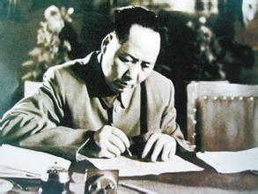
Introduction的写法
伟人是如何写论文Introduction的
毛主席《论持久战》
发表于1938年
精确地预言了抗日战争的走向
“毛先生的大作在今年5月问世后，本人已经多次拜读，并已向委员长作了诚挚推荐。我将毛先生的大作总结成两句话：以空间换时间，积小胜为大胜。”
——白崇禧
1938年11月25日，蒋介石在湖南衡山下召开了一次重要的会议，史称“第一次南岳军事会议”， 给各国民党高级将领人手派发了一本《论持久战》。

Slide 41
例：《论持久战》
伟大抗日战争的一周年纪念，七月七日，快要到了。全民族的力量团结起来，坚持抗战，坚持统一战线，同敌人作英勇的战争，快一年了。这个战争，在东方历史上是空前的，在世界历史上也将是伟大的，全世界人民都关心这个战争。身受战争灾难、为着自己民族的生存而奋斗的每一个中国人，无日不在渴望战争的胜利。然而战争的过程究竟会要怎么样？能胜利还是不能胜利？能速胜还是不能速胜？很多人都说持久战，但是为什么是持久战？怎样进行持久战？很多人都说最后胜利，但是为什么会有最后胜利？怎样争取最后胜利？这些问题，不是每个人都解决了的，甚至是大多数人至今没有解决的。于是失败主义的亡国论者跑出来向人们说：中国会亡，最后胜利不是中国的。某些性急的朋友们也跑出来向人们说：中国很快就能战胜，无需乎费大气力。这些议论究竟对不对呢？我们一向都说：这些议论是不对的。可是我们说的，还没有为大多数人所了解。一半因为我们的宣传解释工作还不够，一半也因为客观事变的发展还没有完全暴露其固有的性质，还没有将其面貌鲜明地摆在人们之前，使人们无从看出其整个的趋势和前途，因而无从决定自己的整套的方针和做法。现在好了，抗战十个月的经验，尽够击破毫无根据的亡国论，也尽够说服急性朋友们的速胜论了。在这种情形下，很多人要求做个总结性的解释。尤其是对持久战，有亡国论和速胜论的反对意见，也有空洞无物的了解。“卢沟桥事变以来，四万万人一齐努力，最后胜利是中国的。”这样一种公式，在广大的人们中流行着。这个公式是对的，但有加以充实的必要。 ……为了使每个共产党员在抗日战争中能够尽其更好和更大的努力，也有着重地研究持久战的必要。因此，我的讲演就来研究持久战。
问题的背景

Slide 42
例：《论持久战》
伟大抗日战争的一周年纪念，七月七日，快要到了。全民族的力量团结起来，坚持抗战，坚持统一战线，同敌人作英勇的战争，快一年了。这个战争，在东方历史上是空前的，在世界历史上也将是伟大的，全世界人民都关心这个战争。身受战争灾难、为着自己民族的生存而奋斗的每一个中国人，无日不在渴望战争的胜利。然而战争的过程究竟会要怎么样？能胜利还是不能胜利？能速胜还是不能速胜？很多人都说持久战，但是为什么是持久战？怎样进行持久战？很多人都说最后胜利，但是为什么会有最后胜利？怎样争取最后胜利？这些问题，不是每个人都解决了的，甚至是大多数人至今没有解决的。于是失败主义的亡国论者跑出来向人们说：中国会亡，最后胜利不是中国的。某些性急的朋友们也跑出来向人们说：中国很快就能战胜，无需乎费大气力。这些议论究竟对不对呢？我们一向都说：这些议论是不对的。可是我们说的，还没有为大多数人所了解。一半因为我们的宣传解释工作还不够，一半也因为客观事变的发展还没有完全暴露其固有的性质，还没有将其面貌鲜明地摆在人们之前，使人们无从看出其整个的趋势和前途，因而无从决定自己的整套的方针和做法。现在好了，抗战十个月的经验，尽够击破毫无根据的亡国论，也尽够说服急性朋友们的速胜论了。在这种情形下，很多人要求做个总结性的解释。尤其是对持久战，有亡国论和速胜论的反对意见，也有空洞无物的了解。“卢沟桥事变以来，四万万人一齐努力，最后胜利是中国的。”这样一种公式，在广大的人们中流行着。这个公式是对的，但有加以充实的必要。 ……为了使每个共产党员在抗日战争中能够尽其更好和更大的努力，也有着重地研究持久战的必要。因此，我的讲演就来研究持久战。
问题的科学描述

Slide 43
例：《论持久战》
伟大抗日战争的一周年纪念，七月七日，快要到了。全民族的力量团结起来，坚持抗战，坚持统一战线，同敌人作英勇的战争，快一年了。这个战争，在东方历史上是空前的，在世界历史上也将是伟大的，全世界人民都关心这个战争。身受战争灾难、为着自己民族的生存而奋斗的每一个中国人，无日不在渴望战争的胜利。然而战争的过程究竟会要怎么样？能胜利还是不能胜利？能速胜还是不能速胜？很多人都说持久战，但是为什么是持久战？怎样进行持久战？很多人都说最后胜利，但是为什么会有最后胜利？怎样争取最后胜利？这些问题，不是每个人都解决了的，甚至是大多数人至今没有解决的。于是失败主义的亡国论者跑出来向人们说：中国会亡，最后胜利不是中国的。某些性急的朋友们也跑出来向人们说：中国很快就能战胜，无需乎费大气力。这些议论究竟对不对呢？我们一向都说：这些议论是不对的。可是我们说的，还没有为大多数人所了解。一半因为我们的宣传解释工作还不够，一半也因为客观事变的发展还没有完全暴露其固有的性质，还没有将其面貌鲜明地摆在人们之前，使人们无从看出其整个的趋势和前途，因而无从决定自己的整套的方针和做法。现在好了，抗战十个月的经验，尽够击破毫无根据的亡国论，也尽够说服急性朋友们的速胜论了。在这种情形下，很多人要求做个总结性的解释。尤其是对持久战，有亡国论和速胜论的反对意见，也有空洞无物的了解。“卢沟桥事变以来，四万万人一齐努力，最后胜利是中国的。”这样一种公式，在广大的人们中流行着。这个公式是对的，但有加以充实的必要。……为了使每个共产党员在抗日战争中能够尽其更好和更大的努力，也有着重地研究持久战的必要。因此，我的讲演就来研究持久战。
前人工作

Slide 44
例：《论持久战》
伟大抗日战争的一周年纪念，七月七日，快要到了。全民族的力量团结起来，坚持抗战，坚持统一战线，同敌人作英勇的战争，快一年了。这个战争，在东方历史上是空前的，在世界历史上也将是伟大的，全世界人民都关心这个战争。身受战争灾难、为着自己民族的生存而奋斗的每一个中国人，无日不在渴望战争的胜利。然而战争的过程究竟会要怎么样？能胜利还是不能胜利？能速胜还是不能速胜？很多人都说持久战，但是为什么是持久战？怎样进行持久战？很多人都说最后胜利，但是为什么会有最后胜利？怎样争取最后胜利？这些问题，不是每个人都解决了的，甚至是大多数人至今没有解决的。于是失败主义的亡国论者跑出来向人们说：中国会亡，最后胜利不是中国的。某些性急的朋友们也跑出来向人们说：中国很快就能战胜，无需乎费大气力。这些议论究竟对不对呢？我们一向都说：这些议论是不对的。可是我们说的，还没有为大多数人所了解。一半因为我们的宣传解释工作还不够，一半也因为客观事变的发展还没有完全暴露其固有的性质，还没有将其面貌鲜明地摆在人们之前，使人们无从看出其整个的趋势和前途，因而无从决定自己的整套的方针和做法。现在好了，抗战十个月的经验，尽够击破毫无根据的亡国论，也尽够说服急性朋友们的速胜论了。在这种情形下，很多人要求做个总结性的解释。尤其是对持久战，有亡国论和速胜论的反对意见，也有空洞无物的了解。“卢沟桥事变以来，四万万人一齐努力，最后胜利是中国的。”这样一种公式，在广大的人们中流行着。这个公式是对的，但有加以充实的必要。……为了使每个共产党员在抗日战争中能够尽其更好和更大的努力，也有着重地研究持久战的必要。因此，我的讲演就来研究持久战。
本文研究的问题及其必要性

Slide 45
01
02
03
04
结构的逻辑性
语句的逻辑性
论证的逻辑性
写作规范
05
06
07
08
Abstract，Title &
Keywords
论文主体
Introduction
Conclusion

Slide 46
Conclusion的写法
你的研究对该领域有什么影响和贡献？？？
总结你这篇文章的工作：
重新阐明一下你的研究问题
总结一下主要的成果
诠释你的发现：
相似与不同
负面的结果
局限性
Implications

Slide 47
Conclusion的写法
例子：
重新阐明研究问题
In this article, a vision-based control scheme to implement automatic cutting tasks for deformable objects is proposed. First, we model the deformable object by combining Kelvin constitutive equation and the traditional spring-mass model. Unknown model parameters are estimated online by the visual feedback of feature points to improve its applicability. Then, the method to generate online the desired pose of the knife is discussed, which can be projected onto the image plane to form a target surface. Therefore, the cutting task can be recast into a region-based visual tracking control problem. To track the target surface on image plane, lines and the distance are chosen as features to determine knife’s posture uniquely. A dynamic-based controller is designed to control the knife to realize visual tracking. Asymptotic convergence of the image errors is rigorously proved by Lyapunov theory. The experimental result with different materials, including sponge, artificial tissues, and pork liver, validated the feasibility of the cutting control algorithm.
However, the proposed method has the drawback that the calibration is needed to obtain the relative pose between the object, the camera, and the robot before the operation, which will increase the complexity of the experimental setup. In the future, an adaptive control algorithm is considered to be designed to estimate unknown parameters, including internal and external parameters of the camera, to simplify the process of operation.

Slide 48
Conclusion的写法
例子：
总结主要成果
In this article, a vision-based control scheme to implement automatic cutting tasks for deformable objects is proposed. First, we model the deformable object by combining Kelvin constitutive equation and the traditional spring-mass model. Unknown model parameters are estimated online by the visual feedback of feature points to improve its applicability. Then, the method to generate online the desired pose of the knife is discussed, which can be projected onto the image plane to form a target surface. Therefore, the cutting task can be recast into a region-based visual tracking control problem. To track the target surface on image plane, lines and the distance are chosen as features to determine knife’s posture uniquely. A dynamic-based controller is designed to control the knife to realize visual tracking. Asymptotic convergence of the image errors is rigorously proved by Lyapunov theory. The experimental result with different materials, including sponge, artificial tissues, and pork liver, validated the feasibility of the cutting control algorithm.
However, the proposed method has the drawback that the calibration is needed to obtain the relative pose between the object, the camera, and the robot before the operation, which will increase the complexity of the experimental setup. In the future, an adaptive control algorithm is considered to be designed to estimate unknown parameters, including internal and external parameters of the camera, to simplify the process of operation.

Slide 49
Conclusion的写法
例子：
In this article, a vision-based control scheme to implement automatic cutting tasks for deformable objects is proposed. First, we model the deformable object by combining Kelvin constitutive equation and the traditional spring-mass model. Unknown model parameters are estimated online by the visual feedback of feature points to improve its applicability. Then, the method to generate online the desired pose of the knife is discussed, which can be projected onto the image plane to form a target surface. Therefore, the cutting task can be recast into a region-based visual tracking control problem. To track the target surface on image plane, lines and the distance are chosen as features to determine knife’s posture uniquely. A dynamic-based controller is designed to control the knife to realize visual tracking. Asymptotic convergence of the image errors is rigorously proved by Lyapunov theory. The experimental result with different materials, including sponge, artificial tissues, and pork liver, validated the feasibility of the cutting control algorithm.
However, the proposed method has the drawback that the calibration is needed to obtain the relative pose between the object, the camera, and the robot before the operation, which will increase the complexity of the experimental setup. In the future, an adaptive control algorithm is considered to be designed to estimate unknown parameters, including internal and external parameters of the camera, to simplify the process of operation.
诠释成果：相似与不同

Slide 50
Conclusion的写法
例子：
In this article, a vision-based control scheme to implement automatic cutting tasks for deformable objects is proposed. First, we model the deformable object by combining Kelvin constitutive equation and the traditional spring-mass model. Unknown model parameters are estimated online by the visual feedback of feature points to improve its applicability. Then, the method to generate online the desired pose of the knife is discussed, which can be projected onto the image plane to form a target surface. Therefore, the cutting task can be recast into a region-based visual tracking control problem. To track the target surface on image plane, lines and the distance are chosen as features to determine knife’s posture uniquely. A dynamic-based controller is designed to control the knife to realize visual tracking. Asymptotic convergence of the image errors is rigorously proved by Lyapunov theory. The experimental result with different materials, including sponge, artificial tissues, and pork liver, validated the feasibility of the cutting control algorithm.
However, the proposed method has the drawback that the calibration is needed to obtain the relative pose between the object, the camera, and the robot before the operation, which will increase the complexity of the experimental setup. In the future, an adaptive control algorithm is considered to be designed to estimate unknown parameters, including internal and external parameters of the camera, to simplify the process of operation.
负面的结果与局限性

Slide 51
01
02
03
04
结构的逻辑性
语句的逻辑性
论证的逻辑性
写作规范
05
06
07
08
Abstract，Title &
Keywords
论文主体
Introduction
Conclusion

Slide 52
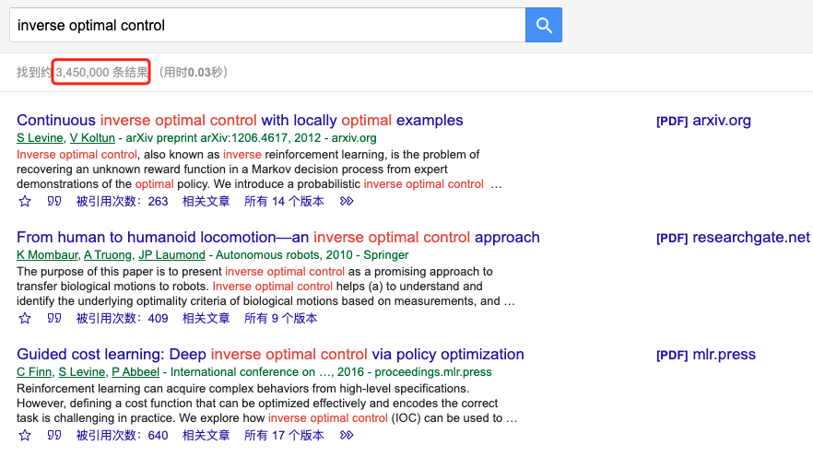
Abstract, Title & Keywords
读者：
这么多文献，我应该看哪篇啊？

Slide 53
Abstract, Title & Keywords
摘要、标题和关键词
只有一个目的：吸引读者的注意力！！！
标题
对你研究内容的最凝练的概括
遵循
避免
Questions
Being too vague
Abbreviations
“New” or “Novel”
State what’s important
Contain keywords
Be as short as possible

Slide 54
Abstract, Title & Keywords
写标题的“套路”
研究对象 + 结果 + 用途（检验对象）
例子：
Effects of gelatin-based biogels for soft robots and electronics
这个标题怎么样？
What type of effects? 结果是什么？
研究对象：
Gelatin-based biogels
结果：
Resilience and degradability
用途（检验对象）：
Soft robots & electronics
结果
describing
研究对象
for
用途

Slide 55
Abstract, Title & Keywords
研究对象
用途
结果
研究对象
for
用途
强调
结果

Slide 56
Abstract, Title & Keywords
Keywords
确定12个左右的Keywords
从杂志的Keywords list中选择
相似文章中的Keywords
在搜素引擎里测试一下
删掉3-4个Keywords
在标题中用2个
从Keywords List选5-6个
在摘要中用3-4次3个Keywords

Slide 57
Abstract, Title & Keywords
Abstract
读者决定要不要读你的文章主要靠读摘要！
摘要通常是读者唯一读的东西
第一印象：
读者：我要不要花时间下载和阅读这篇文章？
审稿人：我要不要花时间来审这篇文章？
为什么要做这项研究?
Introduce topic and problem
我们做了啥?
Aim and challenges
我们取得了啥结果?
Key results
该结果有啥意义?
(If possible)
Conclusions and implications

Slide 58
Abstract, Title & Keywords
例：
The inverse linear-quadratic optimal control problem is a system identification problem whose aim is to recover the quadratic cost function and hence the closed-loop system matrices based on observations of optimal trajectories. In this paper, the discrete-time, finite-horizon case is considered, where the agents are also assumed to be indistinguishable. The latter means that the observations are in terms of “snap shots” of all agents at different time instants, but what is not known is which agent moved where“ for consecutive observations. This absence of linked optimal trajectories makes the problem challenging. We first show that this problem is globally identifiable. Then, for the case of noiseless observations, we show that the true cost matrix, and hence the closed-loop system matrices, can be recovered as the unique global optimal solution to a convex optimization problem. Next, for the case of noisy observations, we formulate an estimator as the unique global optimal solution to a modified convex optimization problem. Moreover, the statistical consistency of this estimator is shown. Finally, the performance of the proposed method is demonstrated by a number of numerical examples.

Slide 59
Abstract, Title & Keywords
例：
Introduce the topic and problem
The inverse linear-quadratic optimal control problem is a system identification problem whose aim is to recover the quadratic cost function and hence the closed-loop system matrices based on observations of optimal trajectories. In this paper, the discrete-time, finite-horizon case is considered, where the agents are also assumed to be indistinguishable. The latter means that the observations are in terms of “snap shots” of all agents at different time instants, but what is not known is which agent moved where“ for consecutive observations. This absence of linked optimal trajectories makes the problem challenging. We first show that this problem is globally identifiable. Then, for the case of noiseless observations, we show that the true cost matrix, and hence the closed-loop system matrices, can be recovered as the unique global optimal solution to a convex optimization problem. Next, for the case of noisy observations, we formulate an estimator as the unique global optimal solution to a modified convex optimization problem. Moreover, the statistical consistency of this estimator is shown. Finally, the performance of the proposed method is demonstrated by a number of numerical examples.

Slide 60
Abstract, Title & Keywords
例：
The inverse linear-quadratic optimal control problem is a system identification problem whose aim is to recover the quadratic cost function and hence the closed-loop system matrices based on observations of optimal trajectories. In this paper, the discrete-time, finite-horizon case is considered, where the agents are also assumed to be indistinguishable. The latter means that the observations are in terms of “snap shots” of all agents at different time instants, but what is not known is which agent moved where“ for consecutive observations. This absence of linked optimal trajectories makes the problem challenging. We first show that this problem is globally identifiable. Then, for the case of noiseless observations, we show that the true cost matrix, and hence the closed-loop system matrices, can be recovered as the unique global optimal solution to a convex optimization problem. Next, for the case of noisy observations, we formulate an estimator as the unique global optimal solution to a modified convex optimization problem. Moreover, the statistical consistency of this estimator is shown. Finally, the performance of the proposed method is demonstrated by a number of numerical examples.
Aim and challenges

Slide 61
Abstract, Title & Keywords
例：
The inverse linear-quadratic optimal control problem is a system identification problem whose aim is to recover the quadratic cost function and hence the closed-loop system matrices based on observations of optimal trajectories. In this paper, the discrete-time, finite-horizon case is considered, where the agents are also assumed to be indistinguishable. The latter means that the observations are in terms of “snap shots” of all agents at different time instants, but what is not known is which agent moved where“ for consecutive observations. This absence of linked optimal trajectories makes the problem challenging. We first show that this problem is globally identifiable. Then, for the case of noiseless observations, we show that the true cost matrix, and hence the closed-loop system matrices, can be recovered as the unique global optimal solution to a convex optimization problem. Next, for the case of noisy observations, we formulate an estimator as the unique global optimal solution to a modified convex optimization problem. Moreover, the statistical consistency of this estimator is shown. Finally, the performance of the proposed method is demonstrated by a number of numerical examples.
Key results

Slide 62
感谢聆听

